Slide 1

8th Grade Math: Pre-Algebra
Unit 8, Lesson 2 Solving Real-World, Multi-Step Equations Volume 2, pg. 11

Slide 2


Benchmark
MA.8.AR.2.1
Solve multi-step linear equations in one variable, with rational number coefficients. Include equations with variables on both sides.
volume 2, pg. 11

Slide 3
Integrated Mathematical Thinking and Reasoning Standards
MA.K12.MTR.4.1 Engage in discussions that reflect on the mathematical thinking of self and others.
MA.K12.MTR.5.1 Use patterns and structure to help understand and connect mathematical concepts.
MA.K12.MTR.6.1 Assess the reasonableness of solutions.
MA.K12.MTR.7.1 Apply mathematics to real-world contexts.
volume 2, pg. 11

Slide 4

Learning Target
I can solve multi-step linear equations from a real-world context.
volume 2, pg. 11

Slide 5

Warm-Up
volume 2, pg. 12

Slide 6
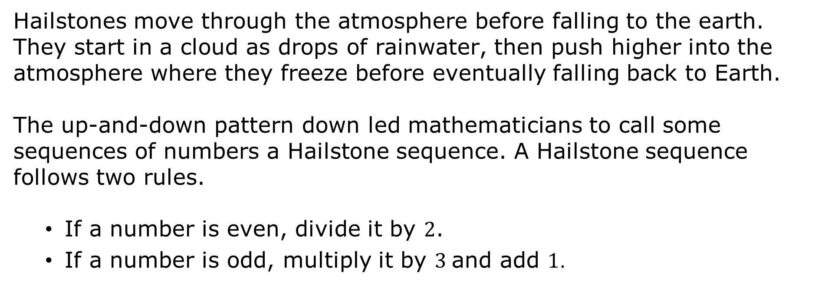
8.2.1 Warm-Up: Hailstone Sequence
Hailstones move through the atmosphere before falling to the earth. They start in a cloud as drops of rainwater, then push higher into the atmosphere where they freeze before eventually falling back to Earth.
The up-and-down pattern down led mathematicians to call some sequences of numbers a Hailstone sequence. A Hailstone sequence follows two rules.
If a number is even, divide it by $2$.
If a number is odd, multiply it by $3$and add $1$.
volume 2, pg. 12

Slide 7
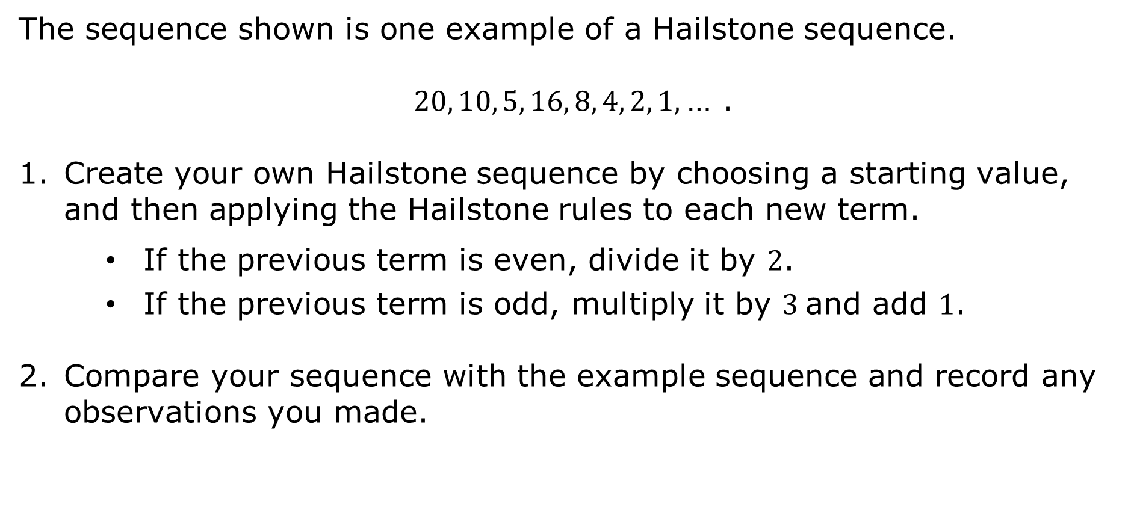
The sequence shown is one example of a Hailstone sequence.
$20, 10, 5, 16, 8, 4, 2, 1$, … .
Create your own Hailstone sequence by choosing a starting value, and then applying the Hailstone rules to each new term.
If the previous term is even, divide it by $2$.
If the previous term is odd, multiply it by $3$and add $1$.
Compare your sequence with the example sequence and record any observations you made.
volume 2, pg. 12

Slide 8

A conjecture is an idea that you think might be true, but do not know for sure.
Based on your observations, make a conjecture about all Hailstone sequences.
In 1937 Lothar Collatz, a mathematician, proposed that for any starting value of a Hailstone sequence, the sequence will always reach 1. Since the conjecture cannot be proven or disproven, it is now called the Collatz Conjecture and is classified as an unsolved problem in mathematics.
volume 2, pg. 12

Slide 9

Collaboration
volume 2, pg. 13

Slide 10

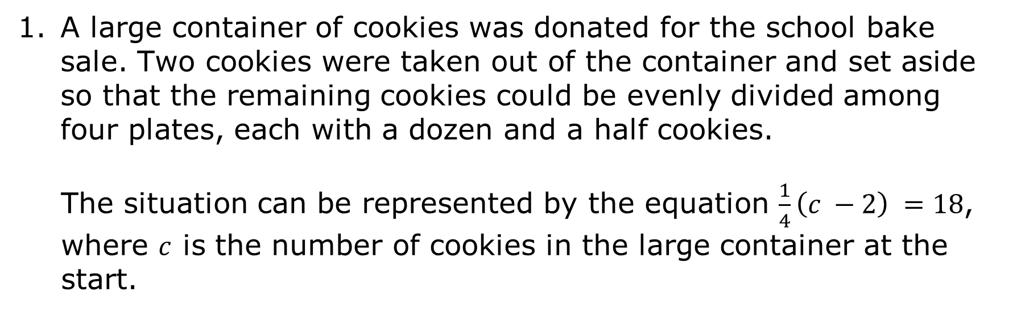
8.2.2 Collaboration: How Many Cookies?
A large container of cookies was donated for the school bake sale. Two cookies were taken out of the container and set aside so that the remaining cookies could be evenly divided among four plates, each with a dozen and a half cookies.
The situation can be represented by the equation $\frac{1}{4}\left(c −2\right) =18$, where $c$ is the number of cookies in the large container at the start.
volume 2, pg. 13

Slide 11
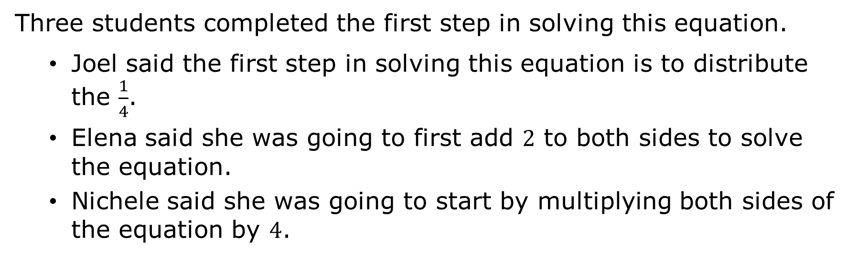
Three students completed the first step in solving this equation.
Joel said the first step in solving this equation is to distribute the $\frac{1}{4}$.
Elena said she was going to first add $2$ to both sides to solve the equation.
Nichele said she was going to start by multiplying both sides of the equation by $4$.
volume 2, pg. 13

Slide 12
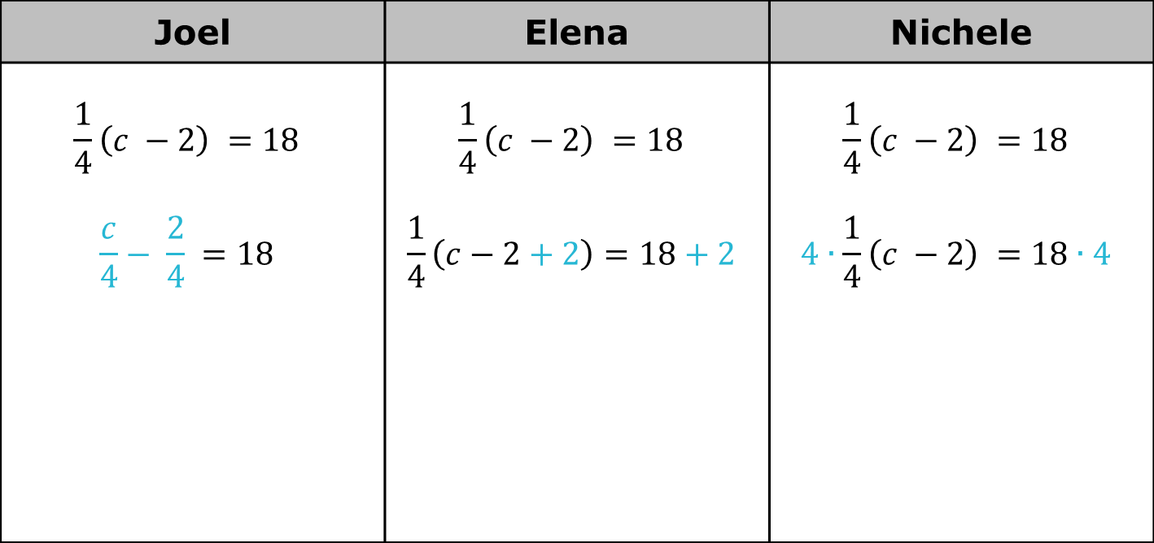
Work with your partner to finish solving the equation using each student’s suggested first step, shown in blue.
Joel | Elena | Nichele
$$\frac{1}{4}\left(c −2\right) =18$$ $$\frac{c}{4}− \frac{2}{4} =18$$ | $$\frac{1}{4}\left(c −2\right) =18$$ $$\frac{1}{4}\left(c−2+2\right)=18+2$$ | $$\frac{1}{4}\left(c −2\right) =18$$ $$4∙\frac{1}{4}\left(c −2\right) =18∙4$$
volume 2, pg. 13

Slide 13
Identify the student who made an error in their first step and explain what error they made.
Complete the statement to interpret the solution in this context.
There were _______ cookies in the large container at the start of the bake sale.
volume 2, pg. 13

Slide 14

Guided Instruction
volume 2, pg. 14

Slide 15
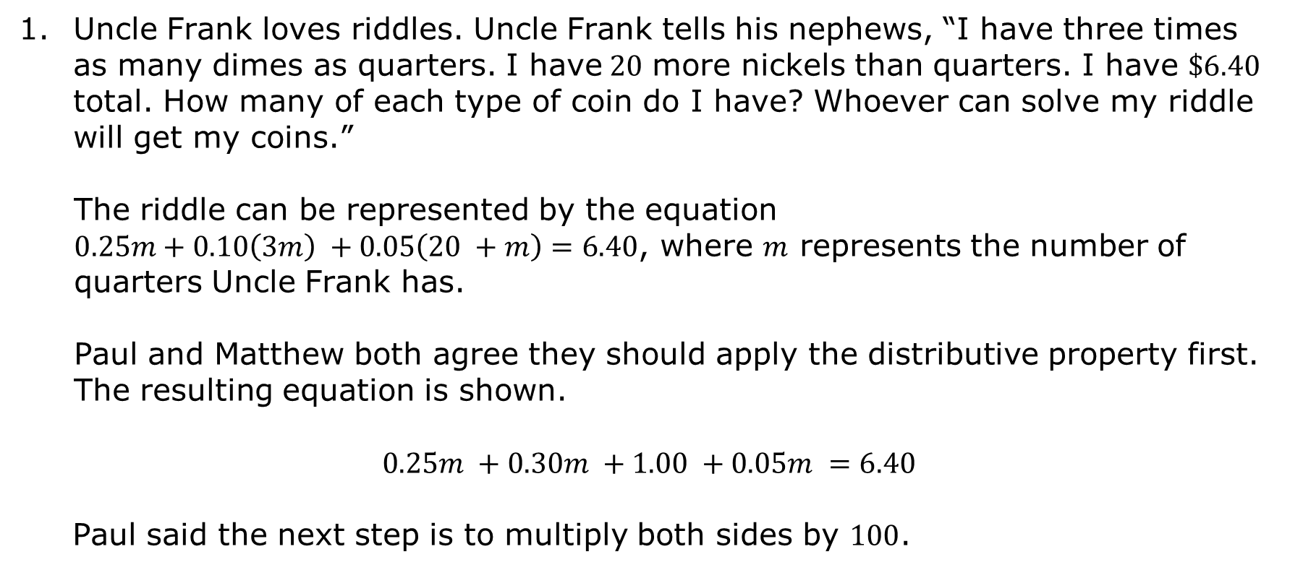
8.2.3 Guided Instruction: Solving Multi-Step Equations in Real-World Contexts
Uncle Frank loves riddles. Uncle Frank tells his nephews, “I have three times as many dimes as quarters. I have$20$ more nickels than quarters. I have $\$6.40$ total. How many of each type of coin do I have? Whoever can solve my riddle will get my coins.”
The riddle can be represented by the equation $0.25m+0.10\left(3m\right) +0.05\left(20 +m\right)=6.40$, where $m$ represents the number of quarters Uncle Frank has.
Paul and Matthew both agree they should apply the distributive property first. The resulting equation is shown.
$$0.25m +0.30m +1.00 +0.05m =6.40$$
Paul said the next step is to multiply both sides by $100$.
volume 2, pg. 14

Slide 16
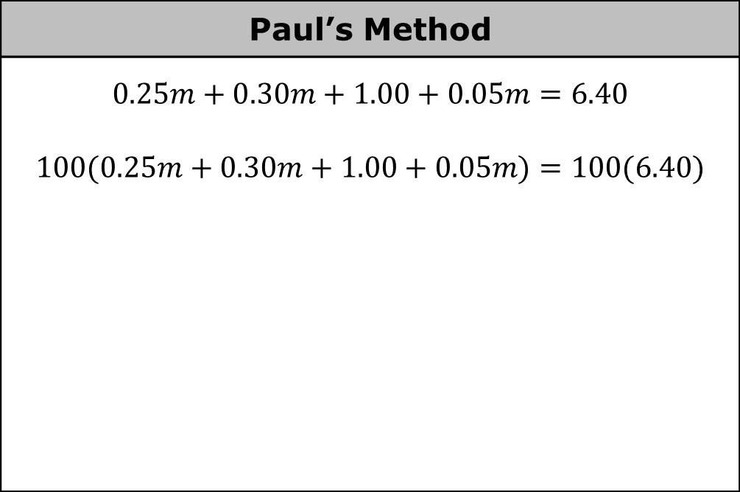
Solve the equation using Paul’s method.
Paul’s Method
$$0.25m+0.30m+1.00+0.05m=6.40$$ $$100(0.25m+0.30m+1.00+0.05m)=100(6.40)$$
What do you notice about the resulting values after multiplying by $100$?
volume 2, pg. 14

Slide 17
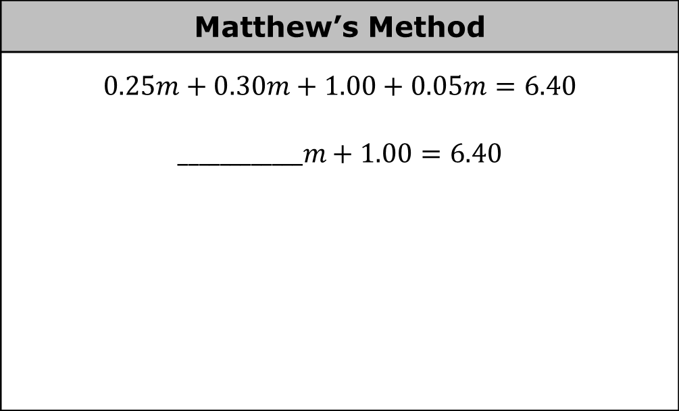
Matthew said it would have been better to first simplify the left side of the equation by combining like terms, then solve.
Solve the equation using Matthew’s method.
Matthew’s Method
$$0.25m+0.30m+1.00+0.05m=6.40$$ $$____________m+1.00=6.40$$
volume 2, pg. 14

Slide 18
Matthew believes that Paul’s method is incorrect. Discuss with your partner if Paul’s method was correct or incorrect. Summarize your discussion.
Explain whose method you prefer for solving this equation.
volume 2, pg. 14

Slide 19
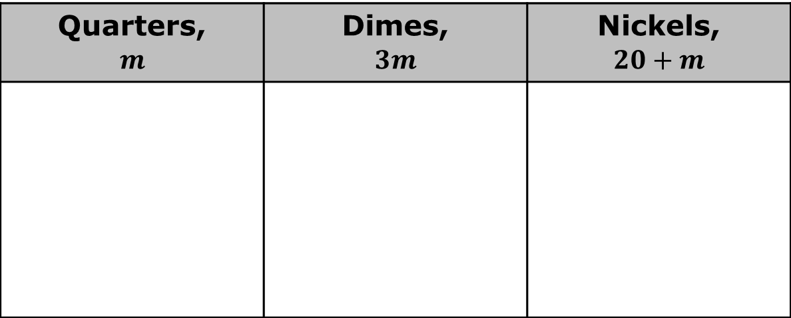
Use the solution to the equation to solve Uncle Frank’s riddle and determine the number of quarters, dimes, and nickels he has.
Quarters, $$m$$ | Dimes, $$3m$$ | Nickels, $$20+m$$
volume 2, pg. 15

Slide 20

Your Turn
volume 2, pg. 15

Slide 21
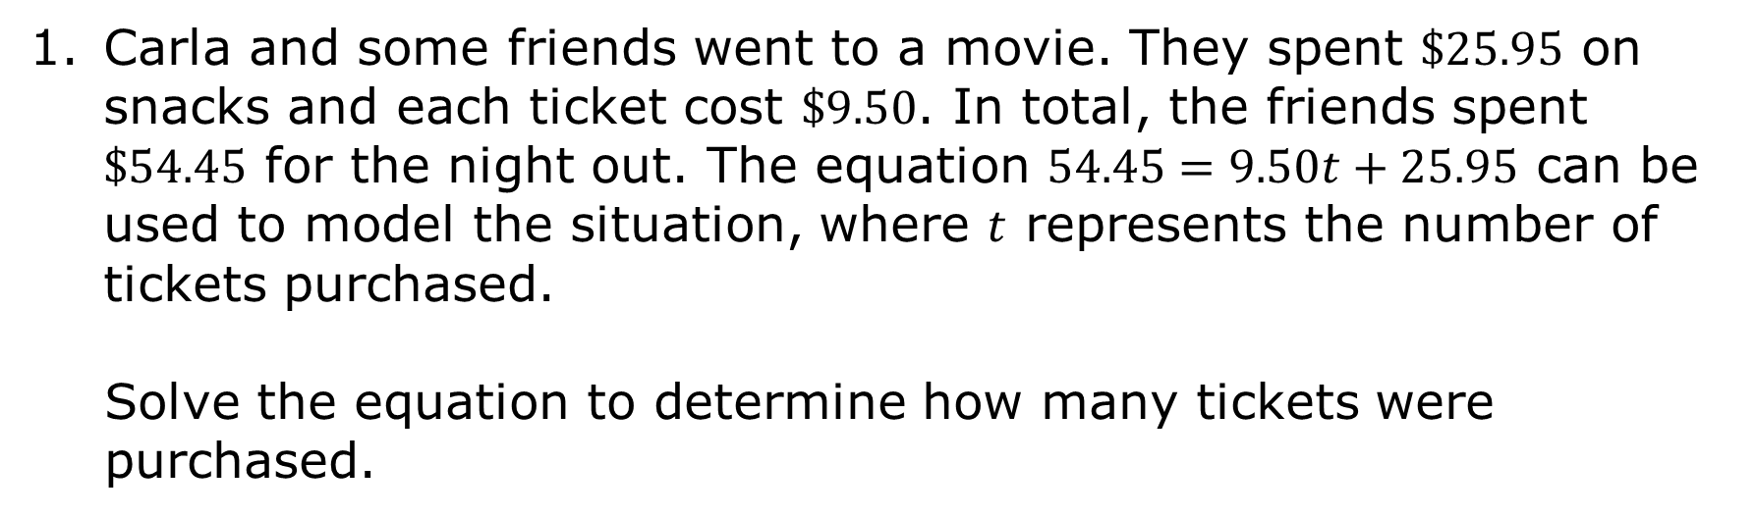
8.2.4 Your Turn!
Carla and some friends went to a movie. They spent $\$25.95$ on snacks and each ticket cost $\$9.50$. In total, the friends spent $\$54.45$ for the night out. The equation $54.45=9.50t+25.95$ can be used to model the situation, where $t$ represents the number of tickets purchased.
Solve the equation to determine how many tickets were purchased.
volume 2, pg. 15

Slide 22
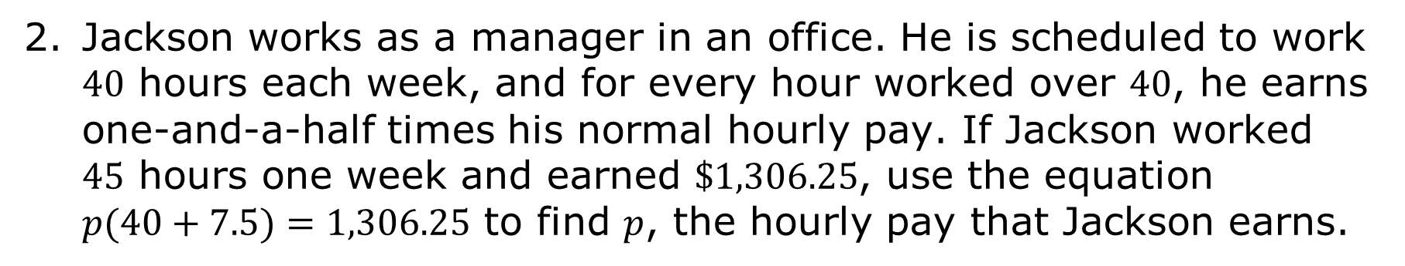
Jackson works as a manager in an office. He is scheduled to work $40$ hours each week, and for every hour worked over $40$, he earns one-and-a-half times his normal hourly pay. If Jackson worked $45$ hours one week and earned $\$1,306.25$, use the equation $p(40+7.5)=1,306.25$ to find $p$, the hourly pay that Jackson earns.
volume 2, pg. 15

Slide 23

Wrap-Up
volume 2, pg. 16

Slide 24
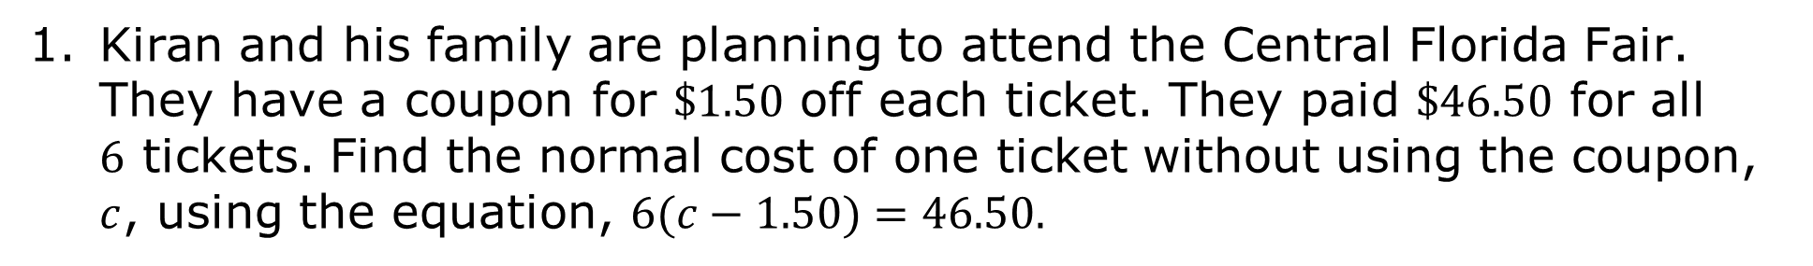
8.2.5 Wrap-Up: Ticket Out the Door
Kiran and his family are planning to attend the Central Florida Fair. They have a coupon for $\$1.50$ off each ticket. They paid $\$46.50$ for all $6$ tickets. Find the normal cost of one ticket without using the coupon, $c$, using the equation, $6(c−1.50)=46.50.$
volume 2, pg. 16

